Slide 1

Micro- en nanotechnology
Lecture 1 by Jessica de Wild

Slide 2
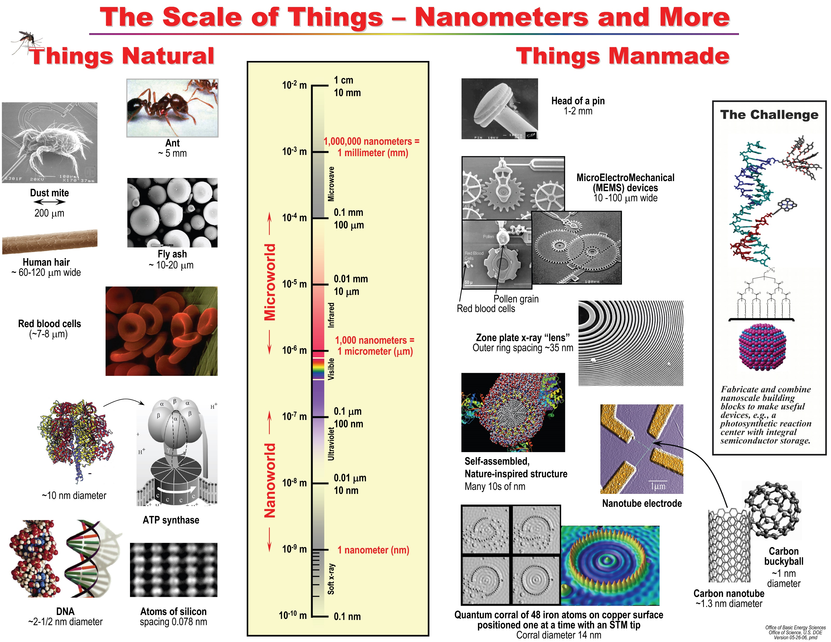
Scale of things

Slide 3
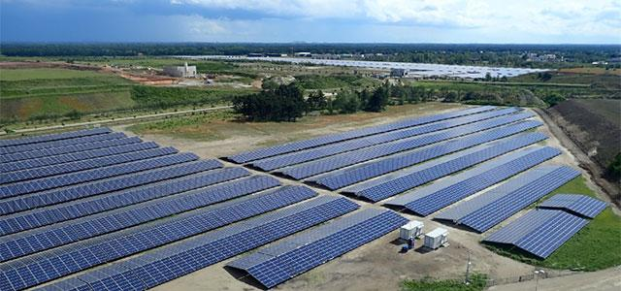
Scale of things
Solar park

Slide 4
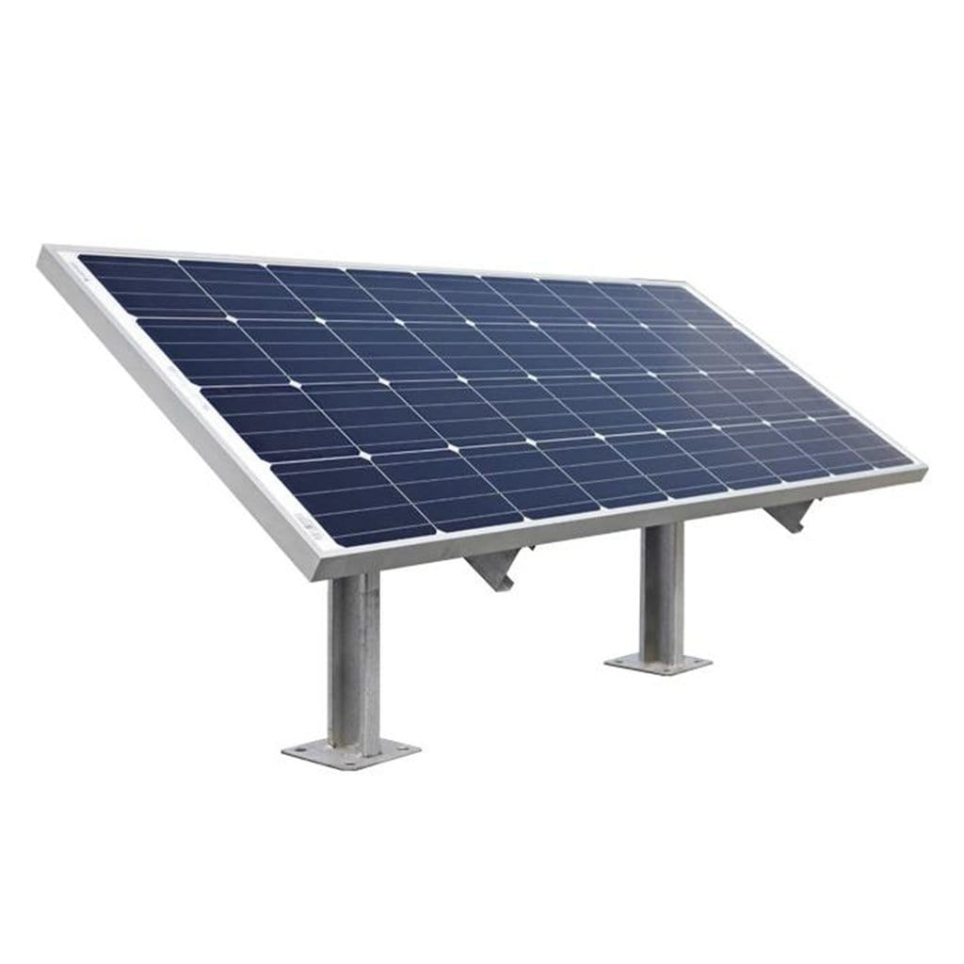
Scale of things
Solar panel

Slide 5
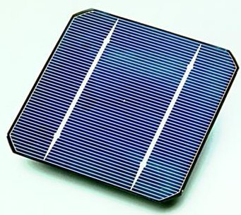
Scale of things
Solar cell
100-300 µm
156-210 mm

Slide 6
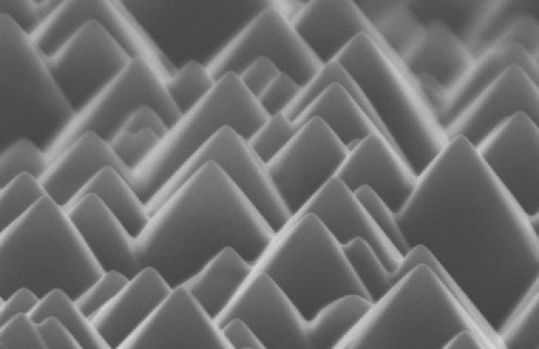
Scale of things
Si wafer texturing
1 µm
https://www.pveducation.org/es/fotovoltaica/surface-texturing

Slide 7
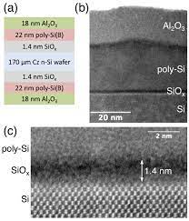
Scale of things
Si wafer surface passivation
https://aip.scitation.org/doi/10.1063/1.5031118

Slide 8
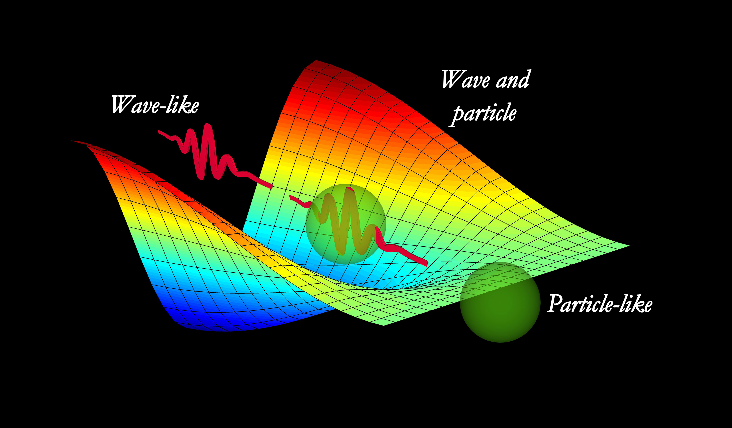
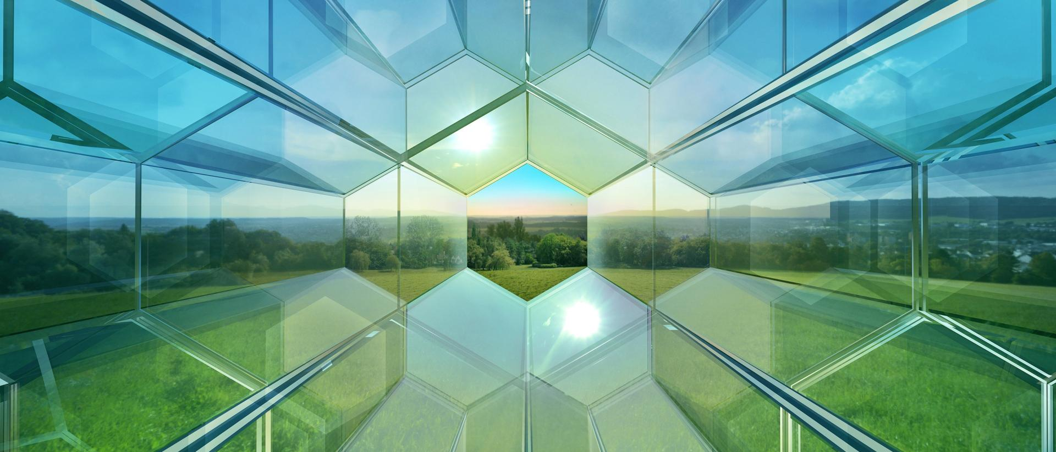
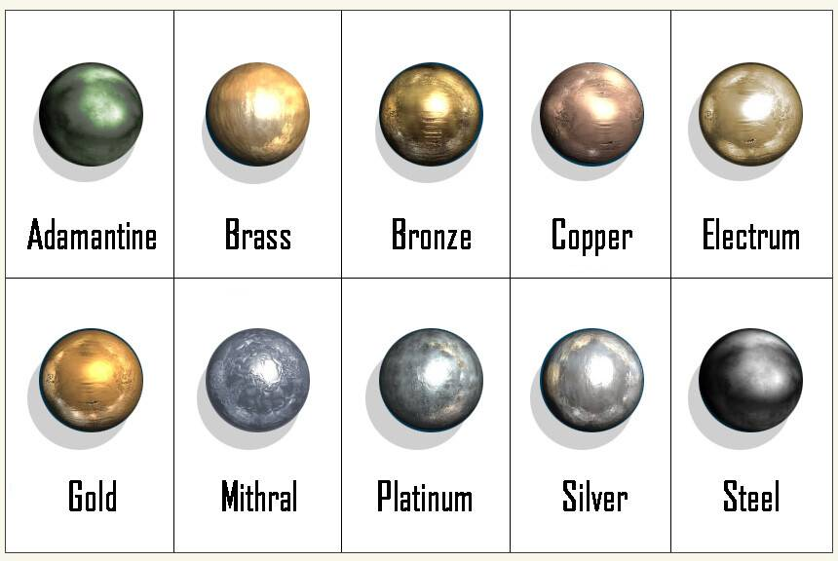
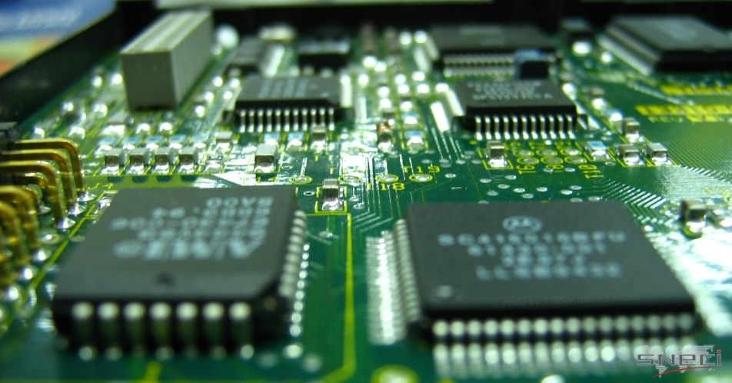
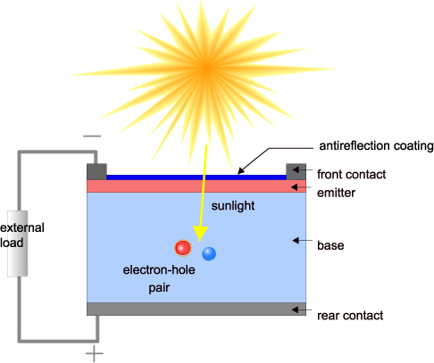
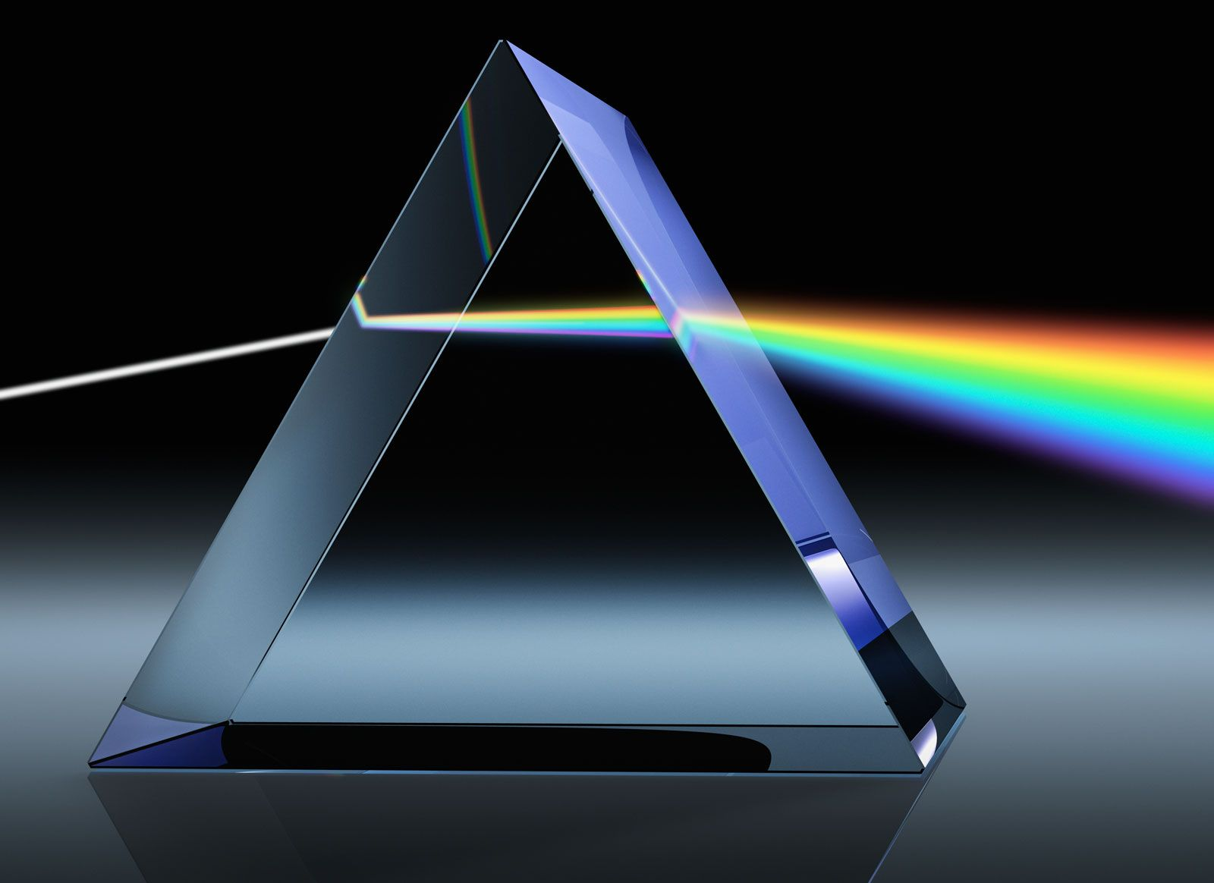
Introduction
Light: waves, energy, optics
Materials: insulator, metal and semi-conductor
Interaction of light with matter

Slide 9
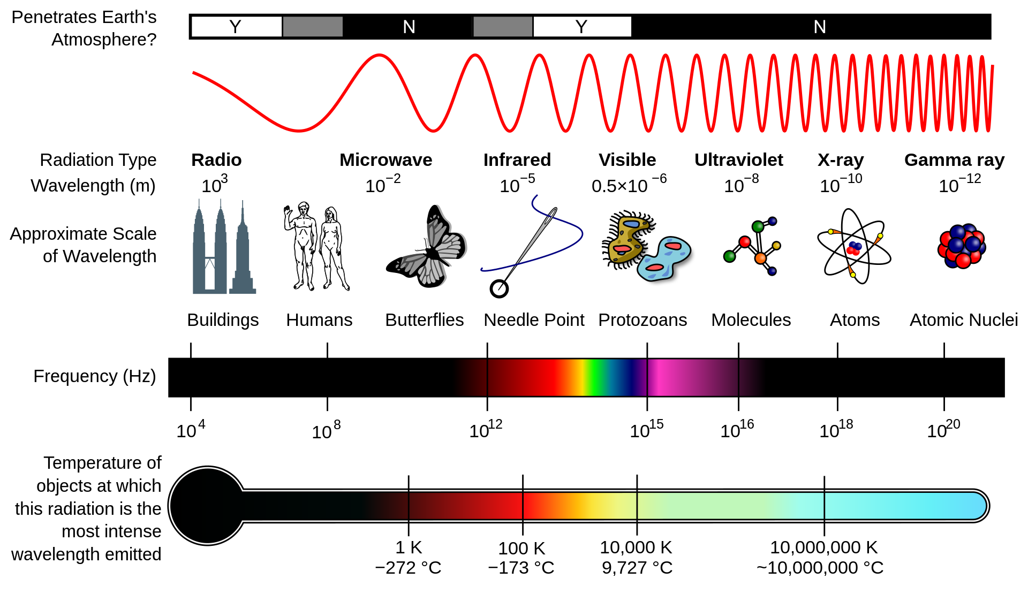
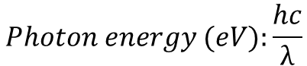
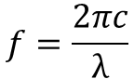
Introduction
Electromagnetic spectrum
$$f=\frac{2πc}{λ}$$
Black body radiation
h: Planck’s constant
c: speed of light
λ: wavelength
$$Photon energy (eV):\frac{hc}{λ}$$
https://commons.wikimedia.org/wiki/File:EM_Spectrum_Properties_edit.svg

Slide 10
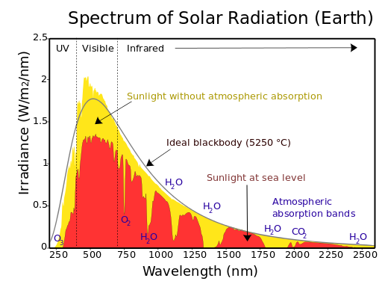
Introduction
Solar spectrum
Solar radiation can be described by black body radiation of 5250 ˚C
On earth, part of radiation is absorbed by the atmosphere
https://www.e-education.psu.edu/meteo300/node/683

Slide 11
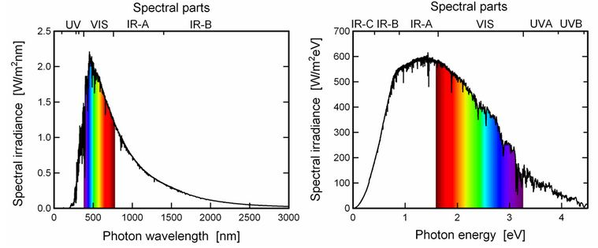
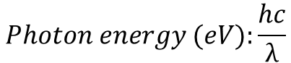
Introduction
Solar spectrum
Wavelength vs energy scale
$$Photon energy (eV):\frac{hc}{λ}$$

Slide 12
Light-matter interaction
Solid materials:
Metals, insulators, semi-conductors → properties of electrical conductivity
Scaling:
Dimensions of material is much larger, smaller or similar to the wavelength of light
Thin film with thickness t
t, r << λ
t, r ~ λ
t, r >> λ
Wavelength λ
Particle size with circumference 2πr

Slide 13
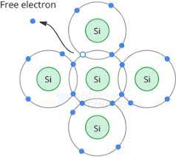
Solid materials
Conductivity
Free electrons in a material conduct electricity
Materials consist of valence electrons that can contribute to conductivity when ionized
Energy required to ionize a valence electron determines the conductive properties of a materials

Slide 14
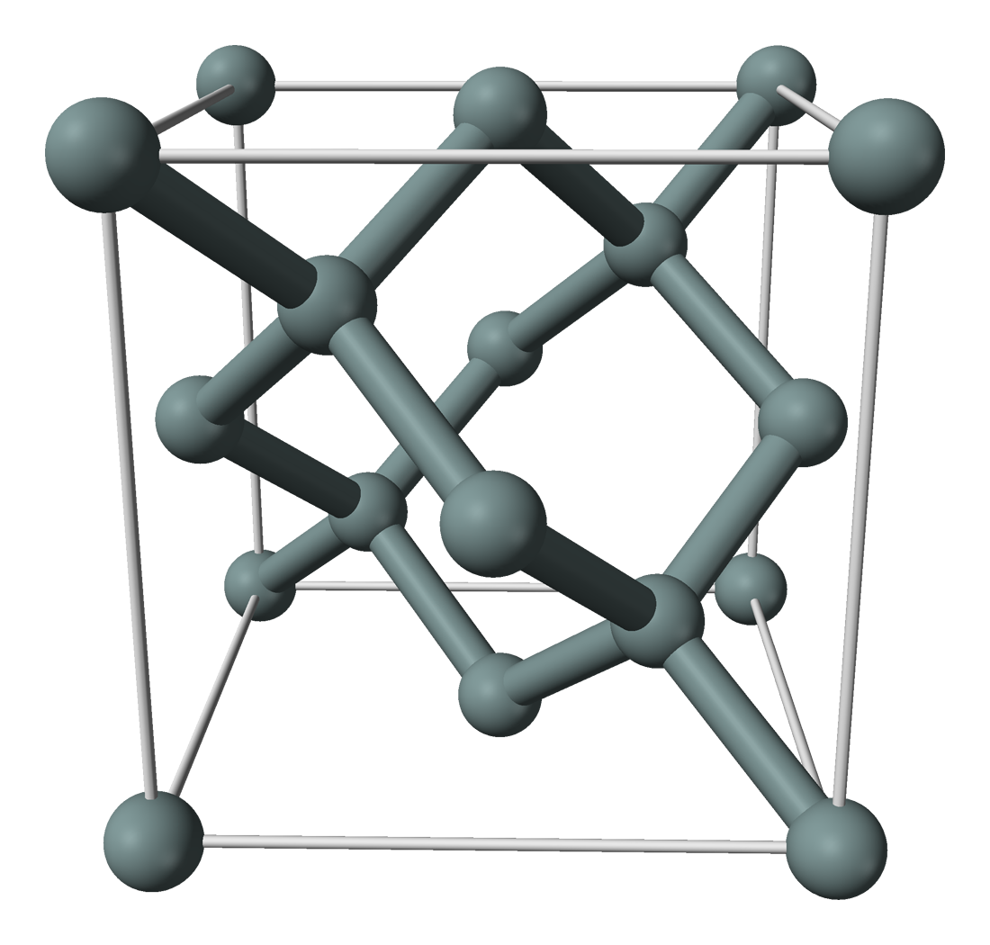
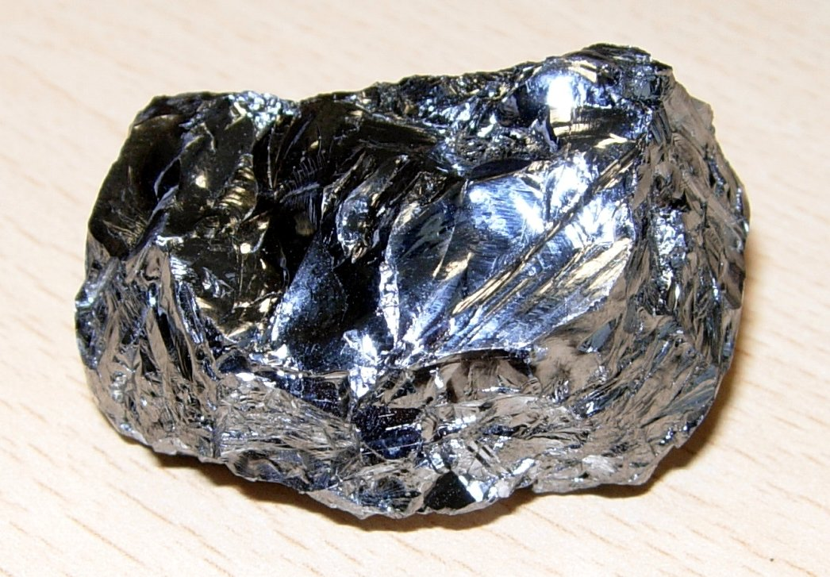
Solid materials
Atomic scale – covalent bonding between 2 Si atoms where each electron has its own energy level
Nano-microscopic scale – Si atoms form a crystalline structure. The number of electrons in such a system becomes so high that electrons form ‘energy bands’: valence band (bound electrons) and conduction band (free electrons)
Si on macroscopic scale
Covalent bonds between Si atoms
Ordering of Si atoms in crystalline structure

Slide 15
Solid materials
Up to few nm: energy levels are discreet
Energy (eV)
Energy (eV)

Slide 16
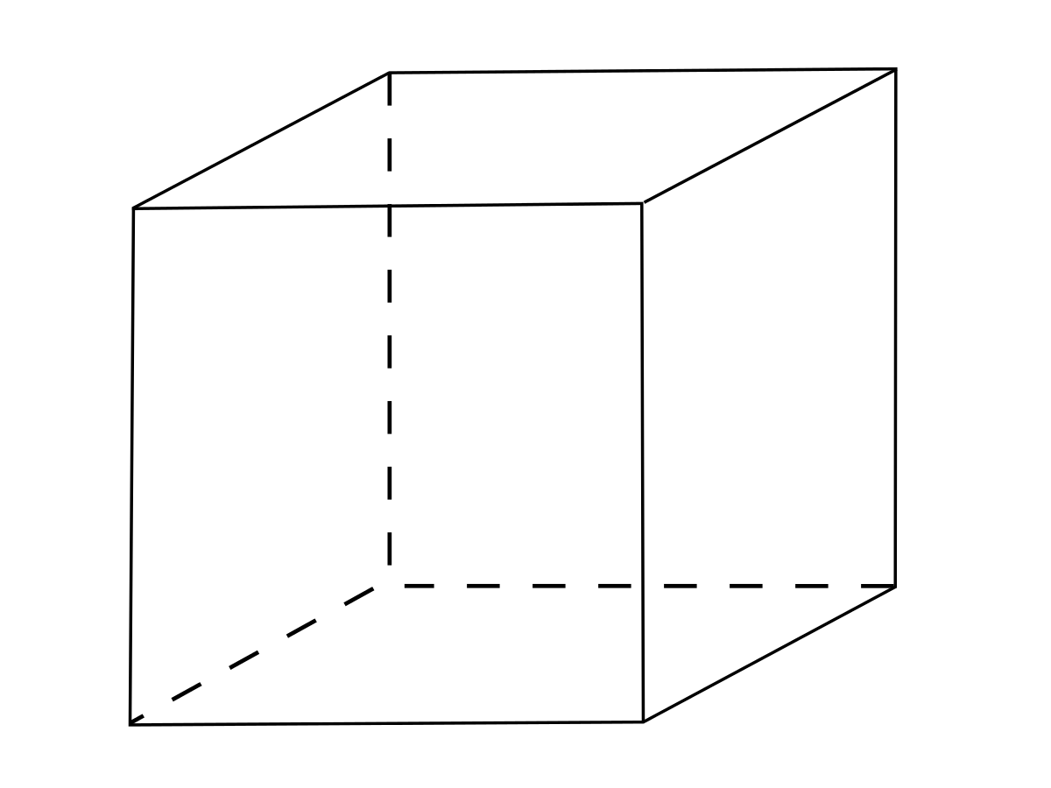
Solid materials
10s of nm and larger (several crystalline building blocks)
The number of electrons in such a system becomes so high that electrons form ‘energy bands’: valence band (bound electrons) and conduction band (free electrons)
Energy (eV)

Slide 17

Solid materials
Conduction band
Conduction band
Conduction band
Energy (eV)
$$γ_{eV}$$
Valence band
Valence band
Valence band
Insulator
Semiconductor
Conductor
Insulators: energy is too high to get electrons in the conduction band → no free electrons
Semi-conductors: electrons can absorb low amount of energy to get into the conduction band
Metals: electrons are in the conduction band

Slide 18
Solid materials
Insulators: plastics, glass, ceramics, rubbers, ...
Metals: Cu, Ag, Zn, ....
Semi-conductors: Si, Ge, Se, compounds like ZnO, In₂O₃, CuInSe₂, CuO, CuS, .....

Slide 19
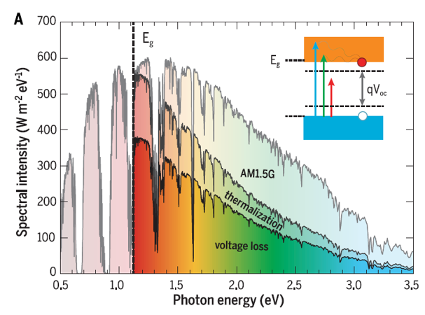

Semi-conductors
Semi-conductor and light absorption
Band gap: distance between upper edge of valence band and lower edge of conduction band
Photons with energy higher than the band gap will be absorbed by the semi-conductor
Conduction band
E_{g}
$$γ_{eV}$$
Valence band

Slide 20
Scaling
Properties of metals and semi-conductor also depend highly on the size
→ Quantum effects play role when particle is much smaller than wavelength of light
Particle size with circumference 2πr
Wavelength λ

Slide 21
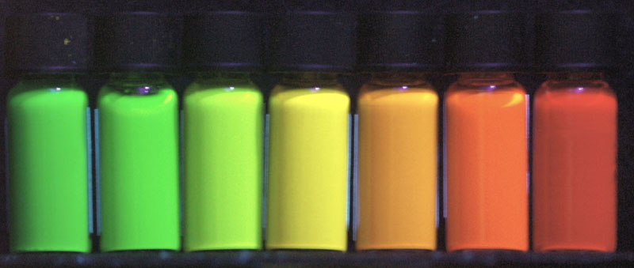
Scaling
In semi-conductor nanoparticles the band gap varies with the size of the nanoparticle
Few nm
10s of nm
Introduction - What is nanotechnology? - Fraunhofer Nanotechnology FNT

Slide 22
Scaling
Metallic nanoparticle absorbs and re-emits light → spherical emitter
Wavelength of highly scattered light depends on the particles size
Particle size with circumference 2πr
Wavelength λ

Slide 23
Scaling
metallic nanoparticle absorbs and re-emits light → spherical emitter
Wavelength of highly scattered light depends on the particles size
Particle size with circumference 2πr
Wavelength λ

Slide 24
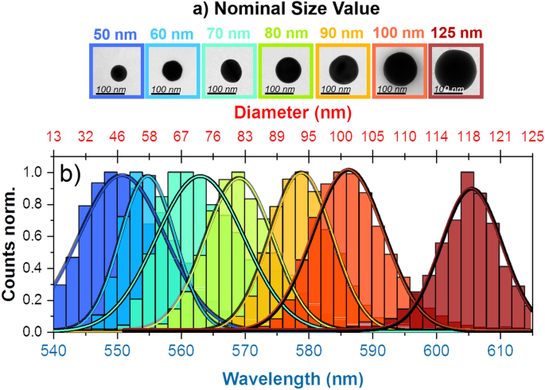
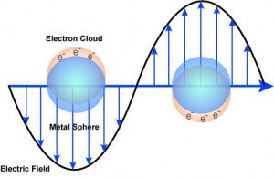
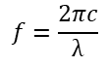
Scaling
In metallic nanoparticles, electrons collectively oscillate depending the frequency ( ) of light
Absorption specific wavelength
$$f=\frac{2πc}{λ}$$

Slide 25
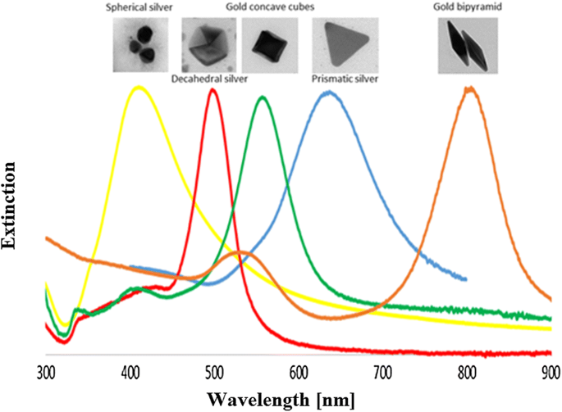
Scaling
Absorption profile of metal nanoparticles depends on the shape and size

Slide 26
Geometrical optics
Light and structures have similar length scale or much larger λ ~ d or λ < d
Thin film with thickness d
Wavelength λ
Structures with dimension ~ λ

Slide 27
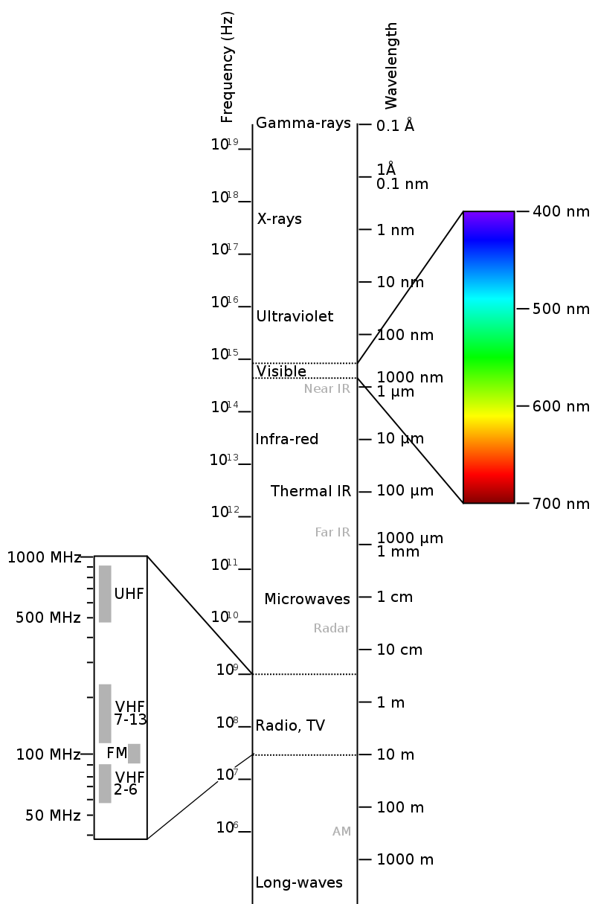
Geometrical optics
Light and structures have similar length scale or much larger
Visible light from ~400 to 700 nm
Thin films and optical structures
~ 10s of nm to few µm

Slide 28
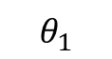
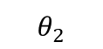
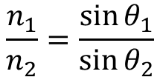
Short introduction optics
Refractive index
Complex number: N = n + ik
Real n: refractive index
Complex k: extinction coefficient
Light diffraction
Snellius’ law
Air
n₁ = 1
Si
n₂ ~ 3.5

Slide 29
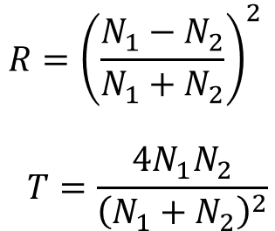
Short introduction optics
Refractive index
Complex number: N = n + ik
Reflection and transmission
Perpendicular incidence
Air
n₁ = 1
Si
n₂ ~ 3.5

Slide 30
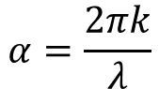
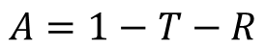
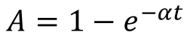
Short introduction optics
Refractive index
Complex number: N = n + ik
Absorption coefficient
thickness
λ is the wavelength of the light
Air
n₁ = 1
Si
n₂ ~ 3.5
t is the thickness of the medium the light in traveling through

Slide 31
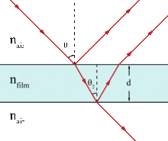
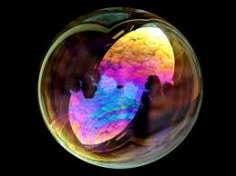

Short introduction optics
Thin film interference
$$2n_{film}d\cos\left(θ_{2}\right)=mλ$$
d = film thickness
m = 1,2,3 etc
When d is much larger than λ, no interference effect
(thicker layers will absorb the light)

Slide 32
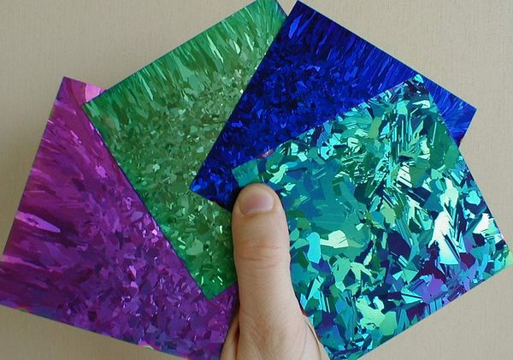
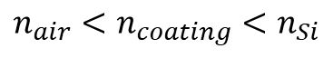
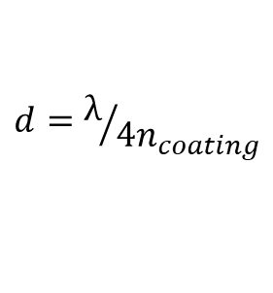
Interference
Anti-reflection coating
$$n_{air}<n_{coating}<n_{Si}$$
$$d=λ/{4n_{coating}}$$
Air
n₁ = 1
Si
n₂ ~ 3.5
Anti-reflection coating
Thickness ~ 70 nm
n ~ 2

Slide 33
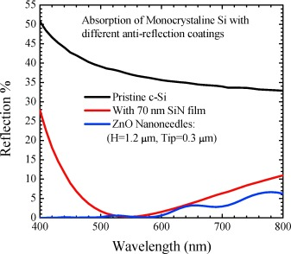
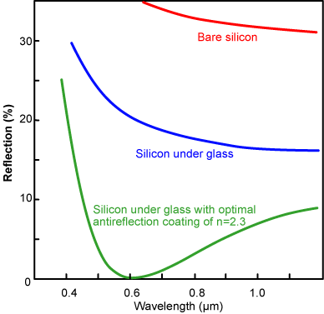
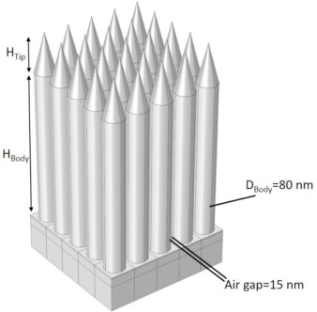
Interference
Anti-reflection coating

Slide 34
Scattering
When light enters a material under an angle, its pathlenths increases
Air
n₁ = 1
Si
n₂ ~ 3.5
Air
n₁ = 1
Si
n₂ ~ 3.5
thickness
thickness

Slide 35
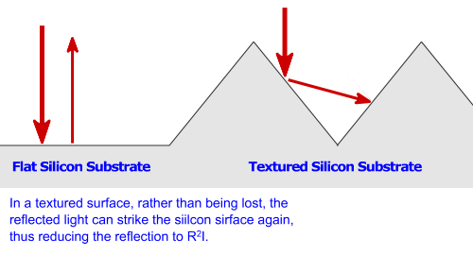
Scattering
Structures with dimensions similar as the wavelength of light
1 µm
Surface Texturing | PVEducation

Slide 36
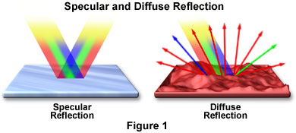
Scattering
Reflection
Smooth surface compared to wavelength of light
Specular reflection
Structures similar or smaller in size as wavelength of light
Diffuse reflection
https://www.olympus-lifescience.com/en/microscope-resource/primer/java/reflection/specular/

Slide 37
Si & thin film photovoltaics
Si waver thickness 150 – 300 µm
Thin films ~ 1 µm
similar physics, but different ‘architectures’
Next two lectures on Si & thin film PV
Interfaces i.e. electrical contacts and formation of pn junctions
Light absorption and light management
First labo: solar cells will be made and measured

